Slide 1
Empowering Patients & Providers
The CommonWell Solution
Blake Wright

Slide 2
What is CommonWell
Purpose:
CommonWell Health Alliance was established with a singular purpose – to confront the formidable challenges of healthcare data interoperability head-on. In an era when timely access to accurate patient information is paramount, CommonWell strives to facilitate the exchange of health data among diverse healthcare entities.
Membership:
Our strength lies in unity. CommonWell boasts a diverse membership, comprising electronic health record (EHR) vendors, hospitals, health systems, and various healthcare IT companies. This collaboration reflects the widespread recognition of the need for coordinated efforts to drive healthcare transformation.
Patient-Centric Approach:
In a world where patients are increasingly active participants in their healthcare journeys, CommonWell champions a patient-centered approach. Patients gain unprecedented access to and control over their health data, encouraging engagement and enhancing care coordination.
Data Access:
CommonWell's remarkable feat is the ability to access a patient's health information from multiple sources, regardless of the EHR system in use. This ensures that healthcare providers have a comprehensive view of a patient's medical history at their fingertips.

Slide 3
What is CommonWell
Nationwide Reach:
CommonWell’s footprint extends far and wide across the United States. CommonWell endeavors to create a nationwide infrastructure for health data exchange, erasing geographical boundaries in the realm of healthcare.
Security and Privacy:
Security and privacy are non-negotiable. CommonWell adheres to stringent standards and regulations, including HIPAA, to safeguard the confidentiality and integrity of health information.
Benefits:
Participating in CommonWell equips healthcare organizations with the tools to streamline care, reduce duplication of tests and procedures, improve patient outcomes, and ultimately lower healthcare costs—a win-win for patients and providers alike.
Interoperability Successes:
CommonWell has already achieved significant successes, with implementations in numerous healthcare institutions. These success stories are a testament to our commitment to making interoperability a reality.

Slide 4
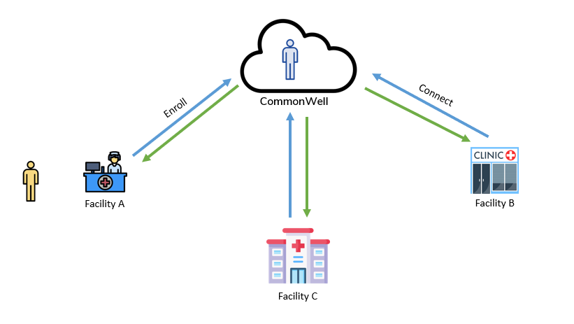
What is CommonWell

Slide 5
CommonWell Today
CommonWell has more than 70 member companies collaborating for the common good.
Members have deployed CommonWell services throughout all 50 states, Washington, D.C and US territories including Puerto Rico.
The network connects 34,000 provider sites, includes more than 194 million unique individuals and has shared 3.5 billion documents to date. Today, CommonWell facilitate the exchange of 30-40 million documents each week across the nation.

Slide 6
Key Terminologies
In understanding CommonWell, it's important to grasp some fundamental terms.
Organization: These are healthcare facilities that provide patient data to CommonWell.
Person: When a patient registers with CommonWell, a "person" is created, which serves as the entity representing the patient
Sources: These are remote provider locations linked to a patient's CommonWell profile, facilitating the retrieval of patient clinical data.

Slide 7
Enabling CommonWell in CureMD
To enable CommonWell within the CureMD application, it's crucial to ensure that specific patient demographic information is present:
First name
Last name
Date of birth
Gender
Address
Zip code
Phone number (preferably mobile)
Before a patient is enrolled in CommonWell, a disclaimer banner is displayed on their profile, indicating the number of possible matching data sources. This banner disappears once chart sharing is enabled.

Slide 8
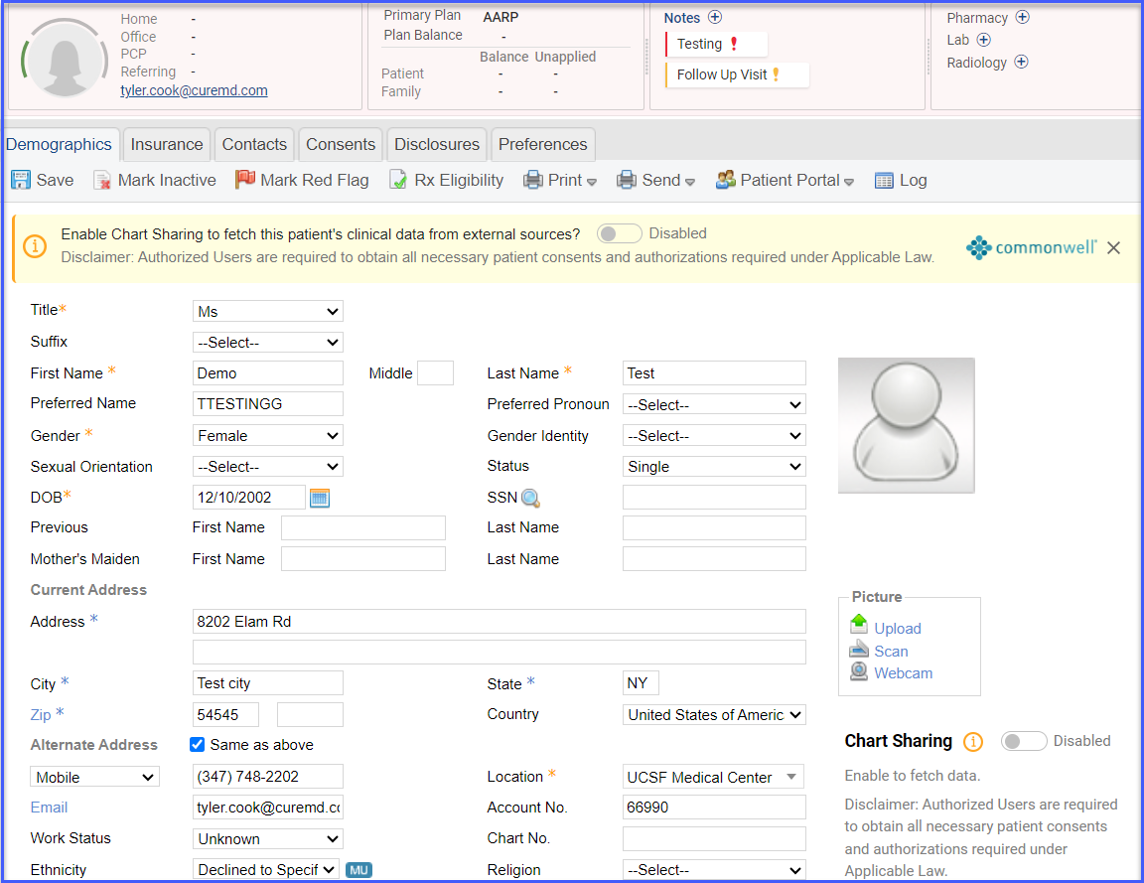
Disclaimer Banner within Patient Demographics Page

Slide 9
Managing User-level Permissions
Users have the ability to manage permissions within CommonWell, controlling who can:
Make changes to a patient's CommonWell profile
Access the external document viewer
Reconcile external documents
By default, all users possess these permissions, but they can be adjusted by following a workflow in the settings menu.

Slide 10
User-level Permissions

Slide 11
Registering Individuals in CommonWell
Person enrollment is the process through which an individual becomes part of the CommonWell system.
The CureMD system can search for duplicate person profiles based on demographic information, streamlining the enrollment process.
If multiple profiles are found, users select the appropriate one to proceed.

Slide 12
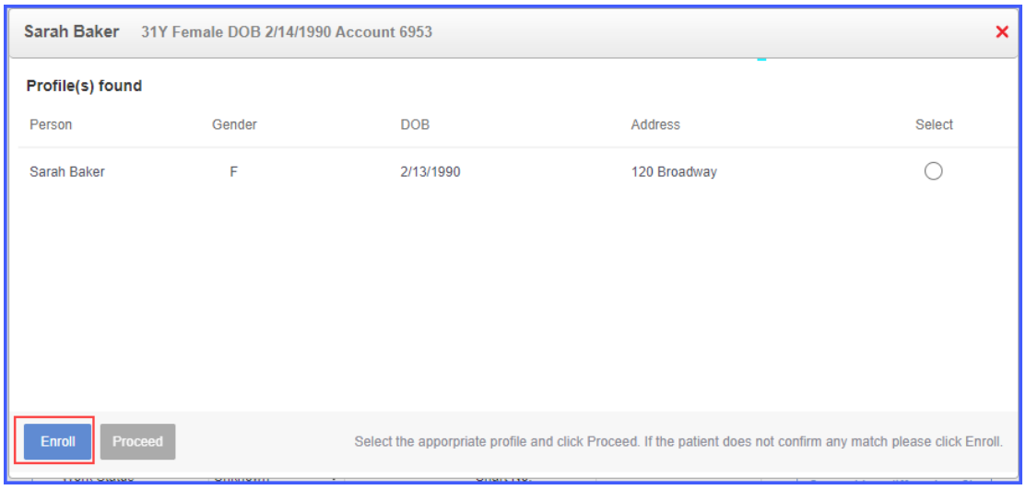
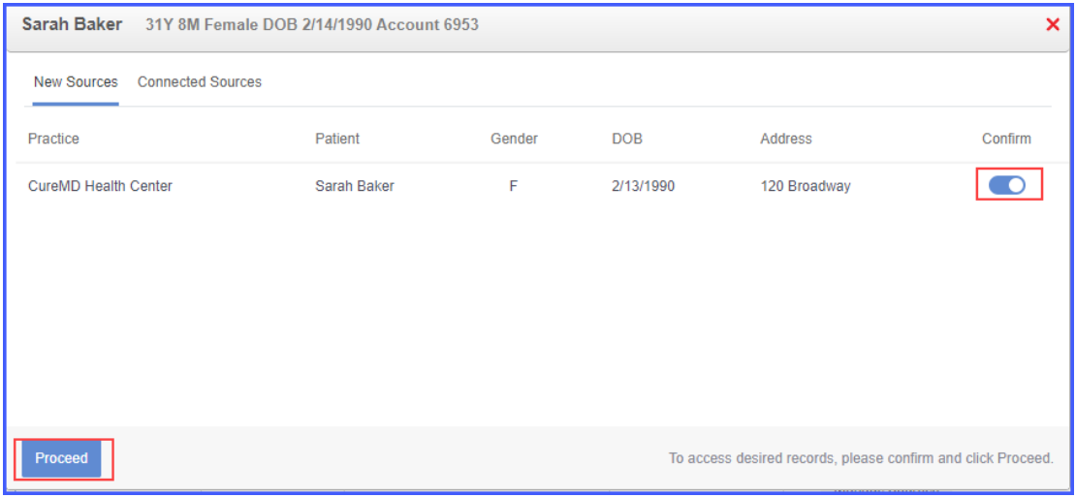
Registering Individuals in CommonWell

Slide 13
Managing Consent and External Documents
Users can make patient consent mandatory for data sharing by configuring settings in the EHR, ensuring compliance with regulatory requirements.
Patients can sign the consent form, and users can access external documents through the viewer.

Slide 14
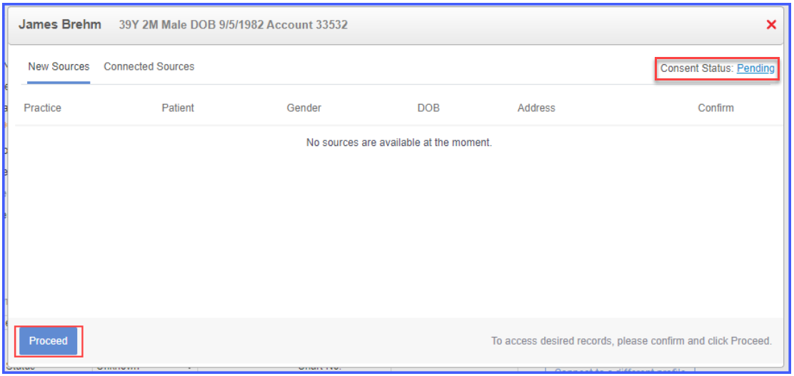
Managing Consent and External Documents

Slide 15
Document Reconciliation and Handling Errors
Reconciliation is the process of integrating external documents into the patient's chart.
Errors or warnings may occur if there are issues with the documents.
Understanding and resolving these issues is vital to ensure data accuracy.

Slide 16
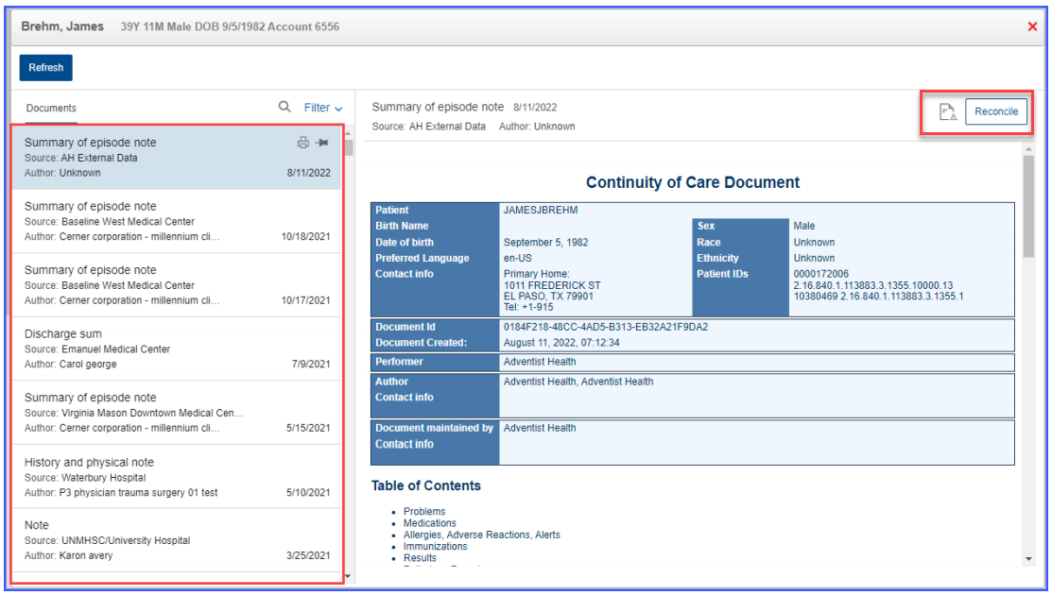
Document Reconciliation and Handling Errors

Slide 17
Opting Out and Tracking Transactions
Patients can opt out of CommonWell by disabling chart sharing through the CommonWell controls on their profile.
Practice users can track outbound transactions to monitor data exchanges within CommonWell.

Slide 18
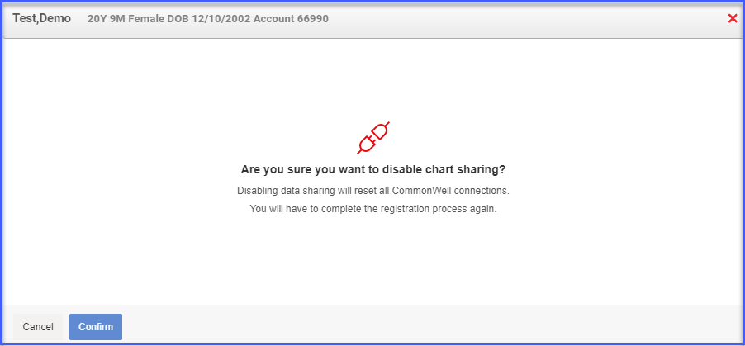
Opting Out and Tracking Transactions

Slide 19
Empowering Healthcare with CommonWell
In conclusion, CommonWell empowers healthcare by bridging data gaps, ensuring data accessibility, and enhancing patient care.
By following these processes and best practices, healthcare providers can harness the full potential of CommonWell.

Slide 20
How Do You Sign-Up with CommonWell?
Is An Agreement Required for CommonWell?
Support staff will share the addendum, with pass-through terms, which needs to be signed by our customers (end users of CommonWell), in addition to our LSA.
Are Customers Required to Sign BAA with CommonWell?
Since, CureMD has BAA with CommonWell, and our customers have BAA with CureMD under the LSA, our Customers do not need to sign any BAA with CommonWell.

Slide 21
Thank You
For your attention

